Slide 1
Module 3: Protocols and Models
Instructor Materials
Introduction to Networks v7.0 (ITN)
Notes:
Cisco Networking Academy Program
Introduction to Networks v7.0 (ITN)
Module 3: Protocols and Modules

Slide 2
Instructor Materials – Module 3 Planning Guide
This PowerPoint deck is divided in two parts:
Instructor Planning Guide
Information to help you become familiar with the module
Teaching aids
Instructor Class Presentation
Optional slides that you can use in the classroom
Begins on slide # 12
Note: Remove the Planning Guide from this presentation before sharing with anyone.
For additional help and resources go to the Instructor Home Page and Course Resources for this course. You also can visit the professional development site on netacad.com, the official Cisco Networking Academy Facebook page, or Instructor Only FB group.
Notes:
2

Slide 3
What to Expect in this Module
To facilitate learning, the following features within the GUI may be included in this module:
Feature | Description
Animations | Expose learners to new skills and concepts.
Videos | Expose learners to new skills and concepts.
Check Your Understanding(CYU) | Per topic online quiz to help learners gauge content understanding.
Interactive Activities | A variety of formats to help learners gauge content understanding.
Syntax Checker | Small simulations that expose learners to Cisco command line to practice configuration skills.
PT Activity | Simulation and modeling activities designed to explore, acquire, reinforce, and expand skills.

Slide 4
What to Expect in this Module (Cont.)
To facilitate learning, the following features may be included in this module:
Feature | Description
Hands-On Labs | Labs designed for working with physical equipment.
Class Activities | These are found on the Instructor Resources page. Class Activities are designed to facilitate learning, class discussion, and collaboration.
Module Quizzes | Self-assessments that integrate concepts and skills learned throughout the series of topics presented in the module.
Module Summary | Briefly recaps module content.

Slide 5
Check Your Understanding
Check Your Understanding activities are designed to let students quickly determine if they understand the content and can proceed, or if they need to review.
Check Your Understanding activities do not affect student grades.
There are no separate slides for these activities in the PPT. They are listed in the notes area of the slide that appears before these activities.
Notes:
5

Slide 6
Module 3: Activities
What activities are associated with this module?
Page # | Activity Type | Activity Name | Optional?
3.0.3 | Class Activity | Design a Communications System | Recommended
3.1.1 | Video | Devices in a Bubble | Recommended
3.1.12 | Check Your Understanding | The Rules | Recommended
3.2.4 | Check Your Understanding | Protocols | Recommended
3.3.6 | Check Your Understanding | Protocol Suites | Recommended
3.4.4 | Lab | Research Networking Standards
3.4.5 | Check Your Understanding | Standards Organizations | Recommended
3.5.5 | Packet Tracer | Investigate the TCP/IP and OSI Models in Action | Recommended
3.6.6 | Check Your Understanding | Data Encapsulation | Recommended
3.7.9 | Lab | Install Wireshark | Recommended
3.7.10 | Lab | Use Wireshark to View Network Traffic | Recommended
3.7.11 | Check Your Understanding | Data Access | Recommended
3.8.2 | Module Quiz | Protocols and Models | Recommended
Notes:
6

Slide 7
Module 3: Best Practices (Cont.)
Prior to teaching Module 3, the instructor should:
Review the activities and assessments for this module.
Try to include as many questions as possible to keep students engaged during classroom presentation.
After this Module, the Basic Networking Connectivity and Communications Exam is available, covering Modules 1-3.
Topic 3.1
Use the mail analogy to introduce how data will be sent across a network.
Discuss the rules of addressing a letter and why the Post Office has these rules.
Discuss how protocols are used in human communication and how they are used in networking.
Notes:
7

Slide 8
Module 3: Best Practices (Cont.)
Topic 3.2
Discuss the different protocol types and why each one is important.
Explain the role of protocol functions in facilitating network communications.
Topic 3.3
Explain why protocol suites are important and why TCP/IP is the primary suite for today.
Discuss the interaction between a user and a web server. Use the animations on page 3.3.5
Topic 3.4
Discuss why open standards are important.
Discuss the advantages and disadvantages of a standards-based protocol and a proprietary protocol.
Notes:
8

Slide 9
Module 3: Best Practices (Cont.)
Topic 3.5
TCP/IP - Students need to memorize the layers and what protocols are found at each layer. See packet tracer activity 3.5.5.
Discuss the advantages and disadvantages using a layered model.
Discuss why the models are vitally important to networking. An analogy would be when studying anatomy, how important is the skeletal structure? This becomes the foundation that anatomy will use to build everything from there. Likewise in networking, we never get far away from the OSI or TCP/IP models when identify what protocol or equipment does, like a switch using MAC addresses and a router using IP addressing. Or when we use top down, bottom up when troubleshooting.
Illustrate the usefulness of the OSI model to troubleshoot with the divide and conquer method. This is when we ping a device that is having issues. If the Layer 3 ICMP ping fails we will look from Layer 3 down… because the issue will be at Layer 1, Layer 2 or Layer 3; however if the ping is good then we look from Layer 4 up because the issues will be at Layer 4, Layer 5, Layer 6, or Layer 7. Examples of higher layer issues are bad authentication, incorrect formatting, etc. Examples of lower layer issues are bad cables, bad connectors, VLAN assignment, bad IP addressing and or subnet masking, etc.
Notes:
9

Slide 10
Module 3: Best Practices (Cont.)
Topic 3.6
Discuss the importance of segmenting the data stream and having the ability to multiplex/interleave traffic.
Consider the analogy of the federal government making a law that all trains had to have the same type of cars and content. Think how inefficient it would be to have all coal cars on one train, all box cars carrying electronics on another, etc. Most areas in the country would have an excess of one item and shortages of others. However, by allowing trains to interleave various cars with variety of items we can supply many products to everyone and minimize shortages.
Notes:
10

Slide 11
Module 3: Best Practices (Cont.)
Topic 3.7
Explain the differences between Layer 3 and Layer 2.
An analogy of traveling by air can be a good way to illustrate this. If someone were flying from point A to point C, but had a layover at city B; our tickets would show that we are flying from A to C and we would label our luggage for C (not B!). This is the same thing L3 does, but inside our envelope we will see that we have several slips of paper. One will say we are leaving a certain gate (say A1) at city A and land at a gate (say B2) in city B. Then we will go gate B3 because our second piece of paper states we will fly from there to C and we will land at gate C3. This is how the layer 2 MAC address will work. Layer 2 is for each leg of the journey, but Layer 3 is for initial source and the final destination.
Notes:
11

Slide 12
Module 3: Protocols and Models
Introduction to Networks 7.0 (ITN)
Notes:
Cisco Networking Academy Program
Introduction to Networks v7.0 (ITN)
Module 3: Protocols and Models

Slide 13
Module Objectives
Module Title: Protocols and Models
Module Objective: Explain how network protocols enable devices to access local and remote network resources.
Topic Title | Topic Objective
The Rules | Describe the types of rules that are necessary to successfully communicate.
Protocols | Explain why protocols are necessary in network communication.
Protocol Suites | Explain the purpose of adhering to a protocol suite.
Standards Organizations | Explain the role of standards organizations in establishing protocols for network interoperability.
Reference Models | Explain how the TCP/IP model and the OSI model are used to facilitate standardization in the communication process.
Data Encapsulation | Explain how data encapsulation allows data to be transported across the network.
Data Access | Explain how local hosts access local resources on a network.
Notes:
13
3 – Protocols and Models
3.0 – Introduction
3.0.2 – What will I learn to do in this module?

Slide 14
Class Activity – Design a Communications System
Design a Communications System
Objectives:
Explain the role of protocols and standards organizations in facilitating interoperability in network communications.
Notes:
14
3 – Protocols and Models
3.0 – Introduction
3.0.3 – Class Activity – Design a Communications System

Slide 15
3.1 The Rules
Notes:
3 – Protocols and Models
3.1 – The Rules

Slide 16
The Rules Video – Devices in a Bubble
This video will explain the protocols that devices use to see their place in the network and communicate with other devices.
Notes:
3 – Protocols and Models
3.1 – The Rules
3.1.1 – Video – Devices in a Bubb
le

Slide 17
The Rules Communications Fundamentals
Networks can vary in size and complexity. It is not enough to have a connection, devices must agree on “how” to communicate.
There are three elements to any communication:
There will be a source (sender).
There will be a destination (receiver).
There will be a channel (media) that provides for the path of communications to occur.
Notes:
3 – Protocols and Models
3.1 – The Rules
3.1.2 –Communications Fundamentals

Slide 18
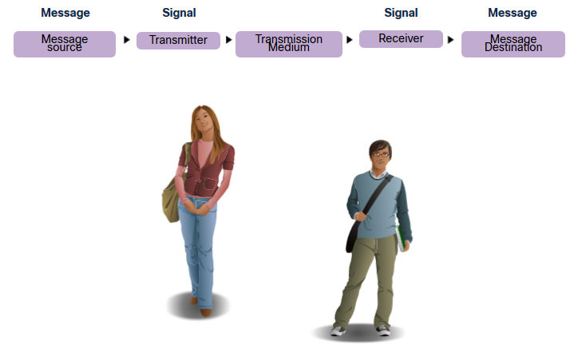
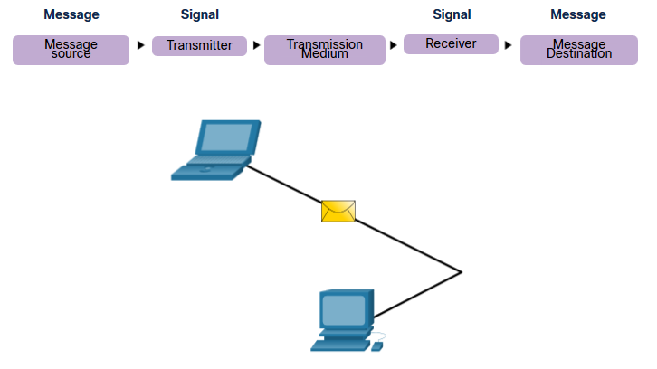
The Rules Communications Protocols
All communications are governed by protocols.
Protocols are the rules that communications will follow.
These rules will vary depending on the protocol.
Notes:
3 – Protocols and Models
3.1 – The Rules
3.1.3 – Communications Protocols

Slide 19
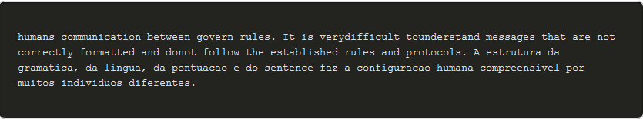
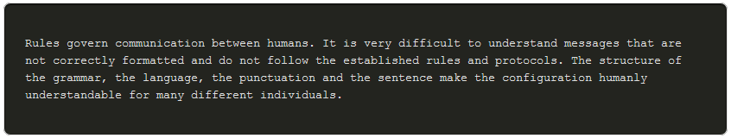
The Rules Rule Establishment
Individuals must use established rules or agreements to govern the conversation.
The first message is difficult to read because it is not formatted properly. The second shows the message properly formatted
Notes:
3 – Protocols and Models
3.1 – The Rules
3.1.4 – Rules Establishment

Slide 20
The Rules Rule Establishment (Cont.)
Protocols must account for the following requirements:
An identified sender and receiver
Common language and grammar
Speed and timing of delivery
Confirmation or acknowledgment requirements
Notes:
3 – Protocols and Models
3.1 – The Rules
3.1.4 – Rules Establishment (Cont.)

Slide 21
The Rules Network Protocol Requirements
Common computer protocols must be in agreement and include the following requirements:
Message encoding
Message formatting and encapsulation
Message size
Message timing
Message delivery options
Notes:
3 – Protocols and Models
3.1 – The Rules
3.1.5 – Network Protocol Requirements

Slide 22
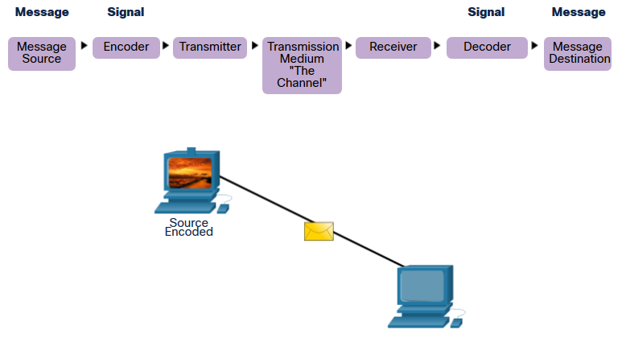
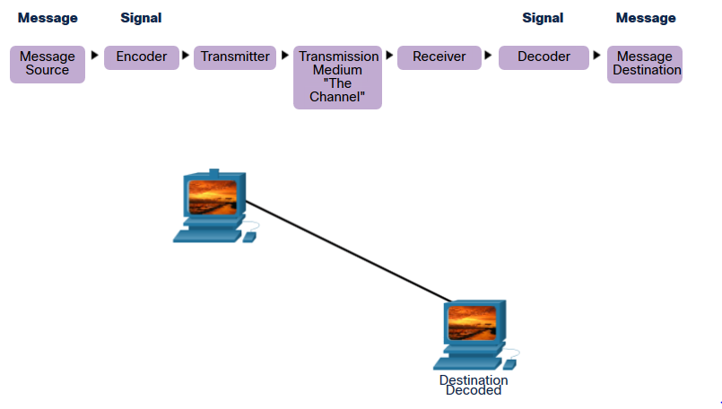
The Rules Message Encoding
Encoding is the process of converting information into another acceptable form for transmission.
Decoding reverses this process to interpret the information.
Notes:
3 – Protocols and Models
3.1 – The Rules
3.1.6 – Message Encoding

Slide 23
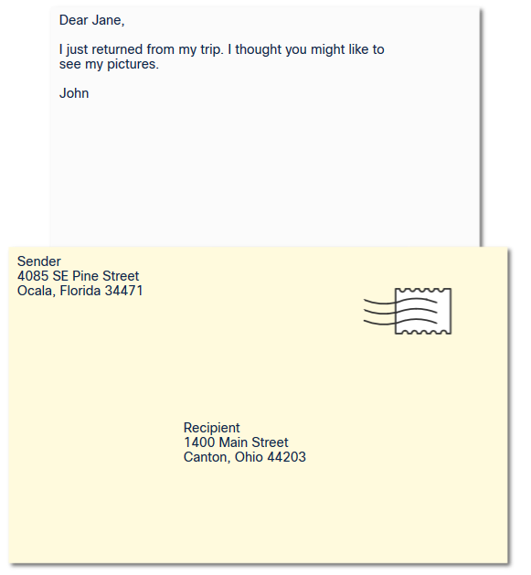
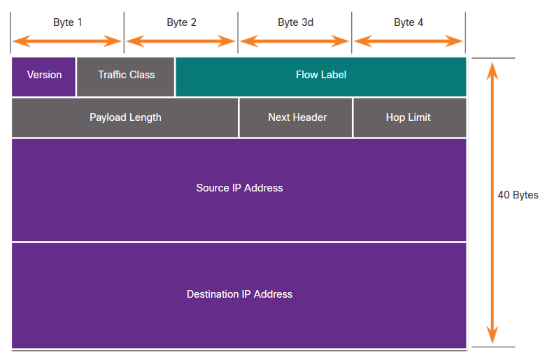
The Rules Message Formatting and Encapsulation
When a message is sent, it must use a specific format or structure.
Message formats depend on the type of message and the channel that is used to deliver the message.
Notes:
3 – Protocols and Models
3.1 – The Rules
3.1.7 – Message Formatting and Encapsulation

Slide 24
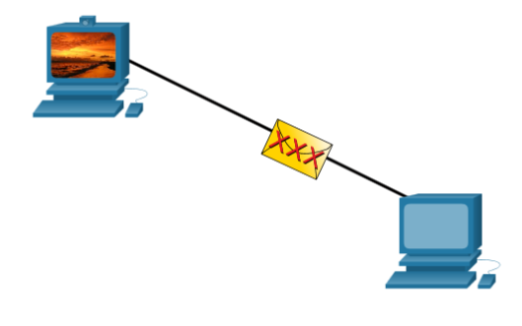
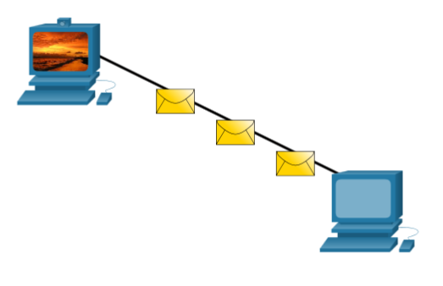
The Rules Message Size
Encoding between hosts must be in an appropriate format for the medium.
Messages sent across the network are converted to bits
The bits are encoded into a pattern of light, sound, or electrical impulses.
The destination host must decode the signals to interpret the message.
Notes:
3 – Protocols and Models
3.1 – The Rules
3.1.8 – Message Size

Slide 25
The Rules Message Timing
Message timing includes the following:
Flow Control – Manages the rate of data transmission and defines how much information can be sent and the speed at which it can be delivered.
Response Timeout – Manages how long a device waits when it does not hear a reply from the destination.
Access method - Determines when someone can send a message.
There may be various rules governing issues like “collisions”. This is when more than one device sends traffic at the same time and the messages become corrupt.
Some protocols are proactive and attempt to prevent collisions; other protocols are reactive and establish a recovery method after the collision occurs.
Notes:
3 – Protocols and Models
3.1 – The Rules
3.1.9 – Message Timing

Slide 26
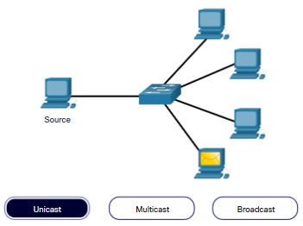
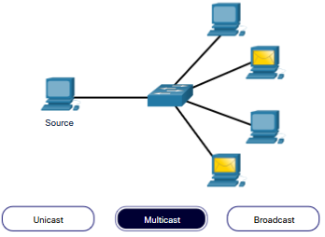
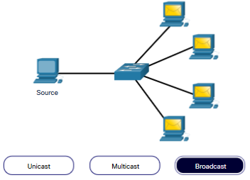
The Rules Message Delivery Options
Message delivery may one of the following methods:
Unicast – one to one communication
Multicast – one to many, typically not all
Broadcast – one to all
Note: Broadcasts are used in IPv4 networks, but are not an option for IPv6. Later we will also see “Anycast” as an additional delivery option for IPv6.
Notes:
3 – Protocols and Models
3.1 – The Rules
3.1.10 – Message Delivery Options

Slide 27
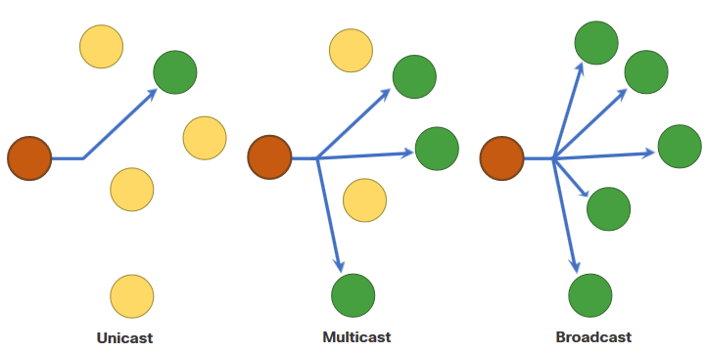
The Rules A Note About the Node Icon
Documents may use the node icon , typically a circle, to represent all devices.
The figure illustrates the use of the node icon for delivery options.
Notes:
3 – Protocols and Models
3.1 – The Rules
3.1.11 – A Note About the Node Icon
3.1.12 – Check Your Understanding – The Rules

Slide 28
3.2 Protocols
Notes:
3 – Protocols and Models
3.2 – Protocols

Slide 29
Protocols Network Protocol Overview
Network protocols define a common set of rules.
Can be implemented on devices in:
Software
Hardware
Both
Protocols have their own:
Function
Format
Rules
Protocol Type | Description
Network Communications | enable two or more devices to communicate over one or more networks
Network Security | secure data to provide authentication, data integrity, and data encryption
Routing | enable routers to exchange route information, compare path information, and select best path
Service Discovery | used for the automatic detection of devices or services
Notes:
3 – Protocols and Models
3.2 – Protocols
3.2.1 – Network Protocol Overview

Slide 30
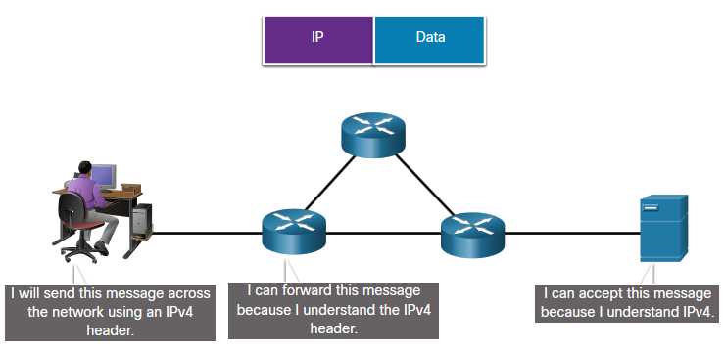
Protocols Network Protocol Functions
Devices use agreed-upon protocols to communicate .
Protocols may have one or many functions.
Function | Description
Addressing | Identifies sender and receiver
Reliability | Provides guaranteed delivery
Flow Control | Ensures data flows at an efficient rate
Sequencing | Uniquely labels each transmitted segment of data
Error Detection | Determines if data became corrupted during transmission
Application Interface | Process-to-process communications between network applications
Notes:
3 – Protocols and Models
3.2 – Protocols
3.2.2 – Network Protocol Functions

Slide 31
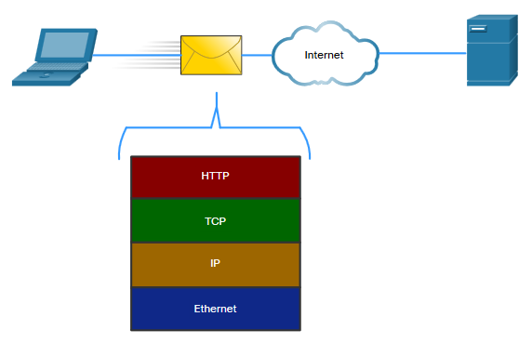
Protocols Protocol Interaction
Networks require the use of several protocols.
Each protocol has its own function and format.
Protocol | Function
Hypertext Transfer Protocol (HTTP) | Governs the way a web server and a web client interact Defines content and format
Transmission Control Protocol (TCP) | Manages the individual conversations Provides guaranteed delivery Manages flow control
Internet Protocol (IP) | Delivers messages globally from the sender to the receiver
Ethernet | Delivers messages from one NIC to another NIC on the same Ethernet Local Area Network (LAN)
Notes:
3 – Protocols and Models
3.2 – Protocols
3.2.3 – Protocol Interaction
3.2.4 – Check Your Understanding - Protocols

Slide 32
3.3 Protocol Suites
Notes:
3 – Protocols and Models
3.3 – Protocol Suites

Slide 33
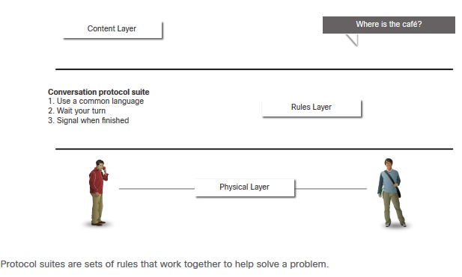
Protocol Suites Network Protocol Suites
Protocols must be able to work with other protocols.
Protocol suite:
A group of inter-related protocols necessary to perform a communication function
Sets of rules that work together to help solve a problem
The protocols are viewed in terms of layers:
Higher Layers
Lower Layers- concerned with moving data and provide services to upper layers
Notes:
3 – Protocols and Models
3.3 – Protocol Suites
3.3.1 – Network Protocol Suites

Slide 34
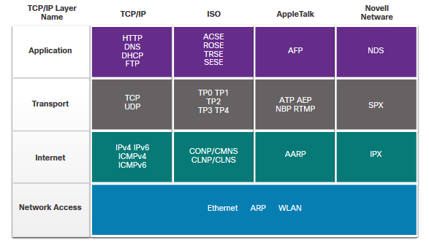
Protocol Suites Evolution of Protocol Suites
There are several protocol suites.
Internet Protocol Suite or TCP/IP- The most common protocol suite and maintained by the Internet Engineering Task Force (IETF)
Open Systems Interconnection (OSI) protocols- Developed by the International Organization for Standardization (ISO) and the International Telecommunications Union (ITU)
AppleTalk- Proprietary suite release by Apple Inc.
Novell NetWare- Proprietary suite developed by Novell Inc.
Notes:
3 – Protocols and Models
3.3 – Protocol Suites
3.3.2 – Evolution of Protocol Suites

Slide 35
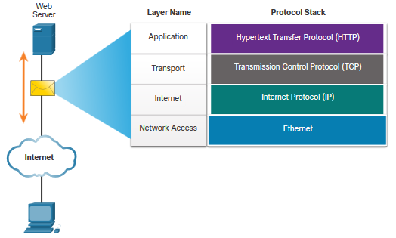
Protocol Suites TCP/IP Protocol Example
TCP/IP protocols operate at the application, transport, and internet layers.
The most common network access layer LAN protocols are Ethernet and WLAN (wireless LAN).
Notes:
3 – Protocols and Models
3.3 – Protocol Suites
3.3.3 – TCP/IP Protocol Example

Slide 36
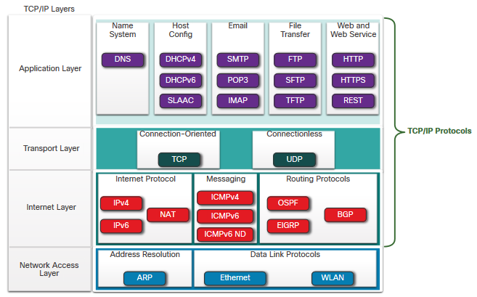
Protocol Suites TCP/IP Protocol Suite
TCP/IP is the protocol suite used by the internet and includes many protocols.
TCP/IP is:
An open standard protocol suite that is freely available to the public and can be used by any vendor
A standards-based protocol suite that is endorsed by the networking industry and approved by a standards organization to ensure interoperability
Notes:
3 – Protocols and Models
3.3 – Protocol Suites
3.3.4 – TCP/IP Protocol Suite

Slide 37
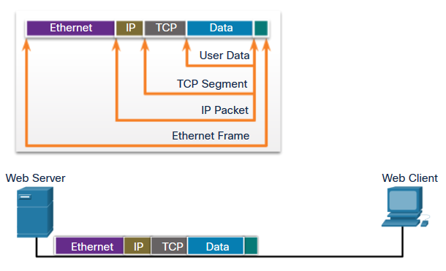
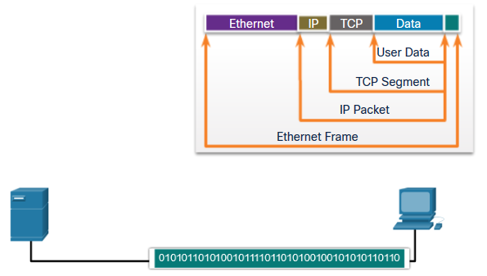
Protocol Suites TCP/IP Communication Process
A web server encapsulating and sending a web page to a client.
A client de-encapsulating the web page for the web browser
Notes:
3 – Protocols and Models
3.3 – Protocol Suites
3.3.5 – TCP/IP Communication Process
3.3.6 – Check Your Understanding – Protocol Suites

Slide 38
3.4 Standards Organizations
Notes:
3 – Protocols and Models
3.4 – Standards Organizations

Slide 39
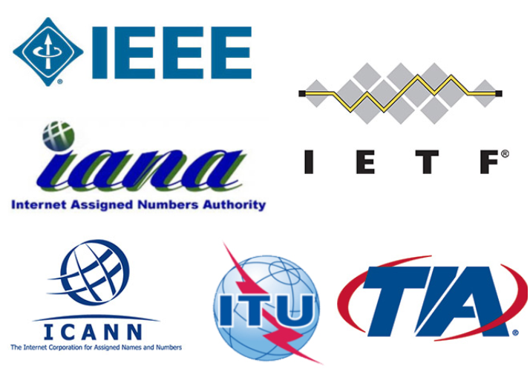
Standards Organizations Open Standards
Open standards encourage:
interoperability
competition
innovation
Standards organizations are:
vendor-neutral
non-profit organizations
established to develop and promote the concept of open standards.
Notes:
3 – Protocols and Models
3.4 – Standards Organizations
3.4.1 – Open Standards

Slide 40
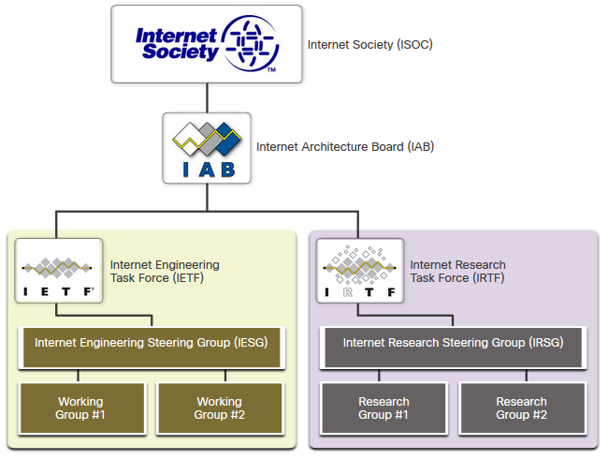
Standards Organizations Internet Standards
Internet Society (ISOC) - Promotes the open development and evolution of internet
Internet Architecture Board (IAB) - Responsible for management and development of internet standards
Internet Engineering Task Force (IETF) - Develops, updates, and maintains internet and TCP/IP technologies
Internet Research Task Force (IRTF) - Focused on long-term research related to internet and TCP/IP protocols
Notes:
3 – Protocols and Models
3.4 – Standards Organizations
3.4.2 – Internet Standards

Slide 41
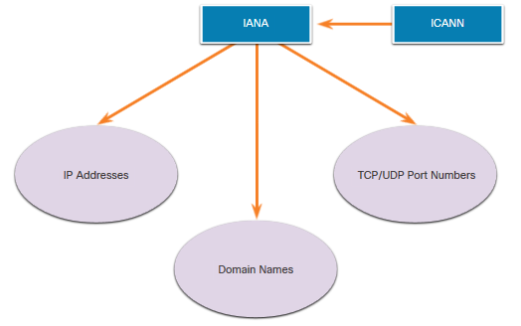
Standards Organizations Internet Standards (Cont.)
Standards organizations involved with the development and support of TCP/IP
Internet Corporation for Assigned Names and Numbers (ICANN) - Coordinates IP address allocation, the management of domain names, and assignment of other information
Internet Assigned Numbers Authority (IANA) - Oversees and manages IP address allocation, domain name management, and protocol identifiers for ICANN
Notes:
3 – Protocols and Models
3.4 – Standards Organizations
3.4.2 – Internet Standards (Cont.)

Slide 42
Standards Organizations Electronic and Communications Standards
Institute of Electrical and Electronics Engineers (IEEE, pronounced “I-triple-E”) - dedicated to creating standards in power and energy, healthcare, telecommunications, and networking
Electronic Industries Alliance (EIA) - develops standards relating to electrical wiring, connectors, and the 19-inch racks used to mount networking equipment
Telecommunications Industry Association (TIA) - develops communication standards in radio equipment, cellular towers, Voice over IP (VoIP) devices, satellite communications, and more
International Telecommunications Union-Telecommunication Standardization Sector (ITU-T) - defines standards for video compression, Internet Protocol Television (IPTV), and broadband communications, such as a digital subscriber line (DSL)
Notes:
3 – Protocols and Models
3.4 – Standards Organizations
3.4.3 – Electronic and Communications Standards

Slide 43
Standards Organizations Lab – Researching Networking Standards
In this lab, you will do the following:
Part 1: Research Networking Standards Organizations
Part 2: Reflect on Internet and Computer Networking Experience
Notes:
3 – Protocols and Models
3.4 – Standards Organizations
3.4.4 – Lab – Researching Networking Standards
3.4.5 – Check Your Understanding – Standards Organizations

Slide 44
3.5 Reference Models
Notes:
3 – Protocols and Models
3.5 – Reference Models

Slide 45
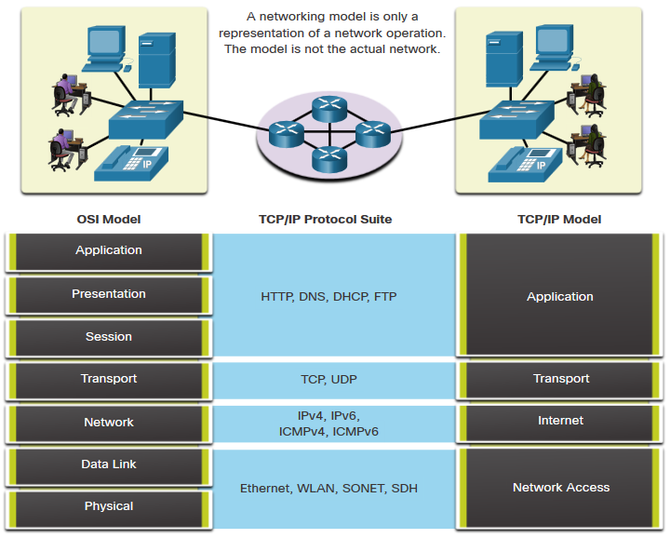
Reference Models The Benefits of Using a Layered Model
Complex concepts such as how a network operates can be difficult to explain and understand. For this reason, a layered model is used.
Two layered models describe network operations:
Open System Interconnection (OSI) Reference Model
TCP/IP Reference Model
Notes:
3 – Protocols and Models
3.5 – Reference Models
3.5.1 – The Benefits of Using a Layered Model

Slide 46
Reference Models The Benefits of Using a Layered Model (Cont.)
These are the benefits of using a layered model:
Assist in protocol design because protocols that operate at a specific layer have defined information that they act upon and a defined interface to the layers above and below
Foster competition because products from different vendors can work together
Prevent technology or capability changes in one layer from affecting other layers above and below
Provide a common language to describe networking functions and capabilities
Notes:
3 – Protocols and Models
3.5 – Reference Models
3.5.1 – The Benefits of Using a Layered Model (Cont.)

Slide 47
Reference Models The OSI Reference Model
OSI Model Layer | Description
7 - Application | Contains protocols used for process-to-process communications.
6 - Presentation | Provides for common representation of the data transferred between application layer services.
5 - Session | Provides services to the presentation layer and to manage data exchange.
4 - Transport | Defines services to segment, transfer, and reassemble the data for individual communications.
3 - Network | Provides services to exchange the individual pieces of data over the network.
2 - Data Link | Describes methods for exchanging data frames over a common media.
1 - Physical | Describes the means to activate, maintain, and de-activate physical connections.
Notes:
3 – Protocols and Models
3.5 – Reference Models
3.5.2 – The OSI Reference Model

Slide 48
Reference Models The TCP/IP Reference Model
TCP/IP Model Layer | Description
Application | Represents data to the user, plus encoding and dialog control.
Transport | Supports communication between various devices across diverse networks.
Internet | Determines the best path through the network.
Network Access | Controls the hardware devices and media that make up the network.
Notes:
3 – Protocols and Models
3.5 – Reference Models
3.5.3 – The TCP/IP Reference Model

Slide 49
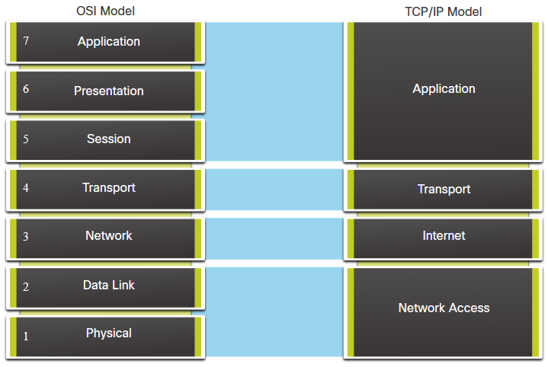
Reference Models OSI and TCP/IP Model Comparison
The OSI model divides the network access layer and the application layer of the TCP/IP model into multiple layers.
The TCP/IP protocol suite does not specify which protocols to use when transmitting over a physical medium.
OSI Layers 1 and 2 discuss the necessary procedures to access the media and the physical means to send data over a network.
Notes:
3 – Protocols and Models
3.5 – Reference Models
3.5.4 – OSI and TCP/IP Model Comparison

Slide 50
Reference Models Packet Tracer – Investigate the TCP/IP and OSI Models in Action
This simulation activity is intended to provide a foundation for understanding the TCP/IP protocol suite and the relationship to the OSI model. Simulation mode allows you to view the data contents being sent across the network at each layer.
In this Packet Tracer, you will:
Part 1: Examine HTTP Web Traffic
Part 2: Display Elements of the TCP/IP Protocol Suite
Notes:
3 – Protocols and Models
3.5 – Reference Models
3.5.5 – Packet Tracer – Investigate the TCP/IP and OSI Models in Action

Slide 51
3.6 Data Encapsulation
Notes:
3 – Protocols and Models
3.6 – Data Encapsulation

Slide 52
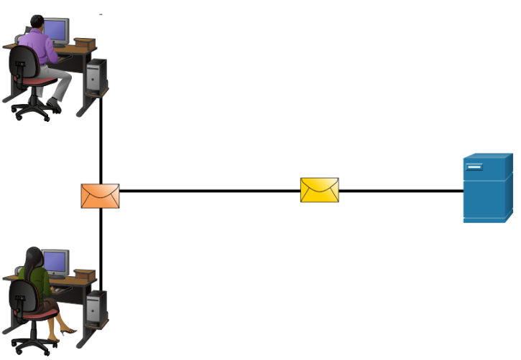
Data Encapsulation Segmenting Messages
Segmenting is the process of breaking up messages into smaller units. Multiplexing is the processes of taking multiple streams of segmented data and interleaving them together.
Segmenting messages has two primary benefits:
Increases speed - Large amounts of data can be sent over the network without tying up a communications link.
Increases efficiency - Only segments which fail to reach the destination need to be retransmitted, not the entire data stream.
Notes:
3 – Protocols and Models
3.6 – Data Encapsulation
3.6.1 – Segmenting Messages

Slide 53
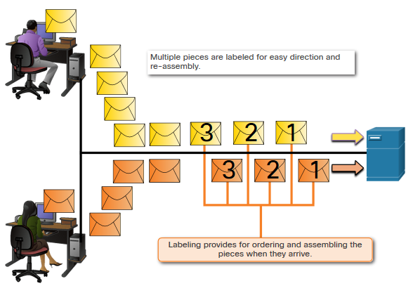
Data Encapsulation Sequencing
Sequencing messages is the process of numbering the segments so that the message may be reassembled at the destination.
TCP is responsible for sequencing the individual segments.
Notes:
3 – Protocols and Models
3.6 – Data Encapsulation
3.6.2 – Sequencing

Slide 54
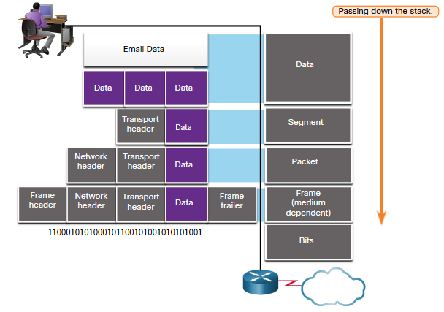
Data Encapsulation Protocol Data Units
Encapsulation is the process where protocols add their information to the data.
At each stage of the process, a PDU has a different name to reflect its new functions.
There is no universal naming convention for PDUs, in this course, the PDUs are named according to the protocols of the TCP/IP suite.
PDUs passing down the stack are as follows:
Data (Data Stream)
Segment
Packet
Frame
Bits (Bit Stream)
Notes:
3 – Protocols and Models
3.6 – Data Encapsulation
3.6.3 – Protocol Data Units

Slide 55
Data Encapsulation Encapsulation Example
Encapsulation is a top down process.
The level above does its process and then passes it down to the next level of the model. This process is repeated by each layer until it is sent out as a bit stream.
Notes:
3 – Protocols and Models
3.6 – Data Encapsulation
3.6.4 – Encapsulation Example

Slide 56
Data Encapsulation De-encapsulation Example
Data is de-encapsulated as it moves up the stack.
When a layer completes its process, that layer strips off its header and passes it up to the next level to be processed. This is repeated at each layer until it is a data stream that the application can process.
Received as Bits (Bit Stream)
Frame
Packet
Segment
Data (Data Stream)
Notes:
3 – Protocols and Models
3.6 – Data Encapsulation
3.6.5 – De-encapsulation Example
3.6.6 – Check Your Understanding – Data Encapsulation

Slide 57
3.7 Data Access
Notes:
3 – Protocols and Models
3.7 – Data Access

Slide 58
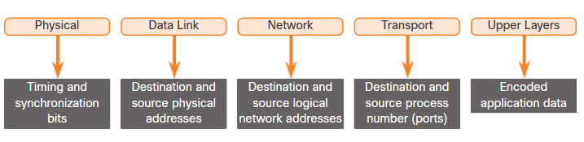
Data Access Addresses
Both the data link and network layers use addressing to deliver data from source to destination.
Network layer source and destination addresses - Responsible for delivering the IP packet from original source to the final destination.
Data link layer source and destination addresses – Responsible for delivering the data link frame from one network interface card (NIC) to another NIC on the same network.
Notes:
3 – Protocols and Models
3.7 – Data Access
3.7.1 – Addresses

Slide 59
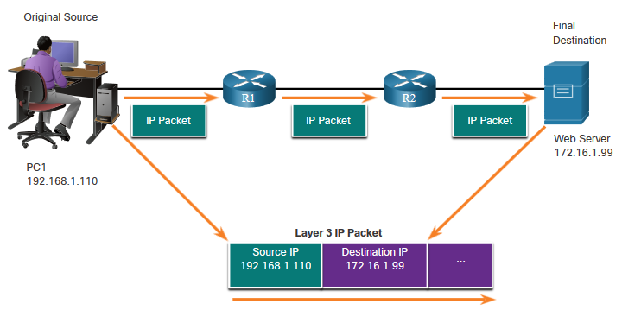
Data Access Layer 3 Logical Address
The IP packet contains two IP addresses:
Source IP address - The IP address of the sending device, original source of the packet.
Destination IP address - The IP address of the receiving device, final destination of the packet.
These addresses may be on the same link or remote.
Notes:
3 – Protocols and Models
3.7 – Data Access
3.7.2 – Layer 3 Logical Address

Slide 60
Data Access Layer 3 Logical Address (Cont.)
An IP address contains two parts:
Network portion (IPv4) or Prefix (IPv6)
The left-most part of the address indicates the network group which the IP address is a member.
Each LAN or WAN will have the same network portion.
Host portion (IPv4) or Interface ID (IPv6)
The remaining part of the address identifies a specific device within the group.
This portion is unique for each device on the network.
Notes:
3 – Protocols and Models
3.7 – Data Access
3.7.2 – Layer 3 Logical Address (Cont.)

Slide 61
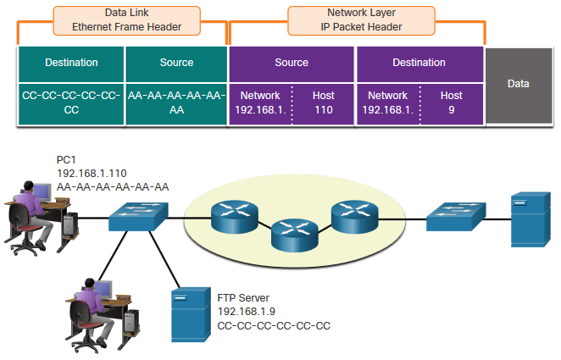
Data Access Devices on the Same Network
When devices are on the same network the source and destination will have the same number in network portion of the address.
PC1 – 192.168.1.110
FTP Server – 192.168.1.9
Notes:
3 – Protocols and Models
3.7 – Data Access
3.7.3 – Devices on the Same Network-

Slide 62
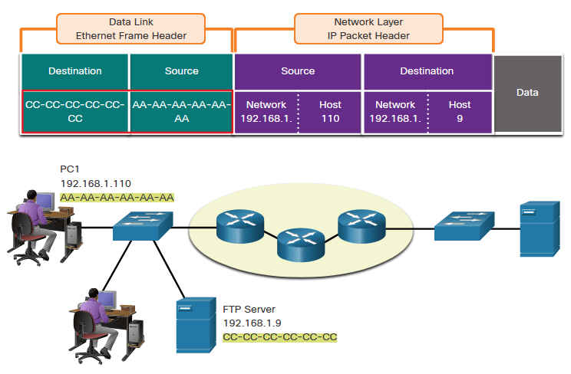
Data Access Role of the Data Link Layer Addresses: Same IP Network
When devices are on the same Ethernet network the data link frame will use the actual MAC address of the destination NIC.
MAC addresses are physically embedded into the Ethernet NIC and are local addressing.
The Source MAC address will be that of the originator on the link.
The Destination MAC address will always be on the same link as the source, even if the ultimate destination is remote.
Notes:
3 – Protocols and Models
3.7 – Data Access
3.7.4 – Role of the Data Link Layer Addresses: Same IP Network

Slide 63
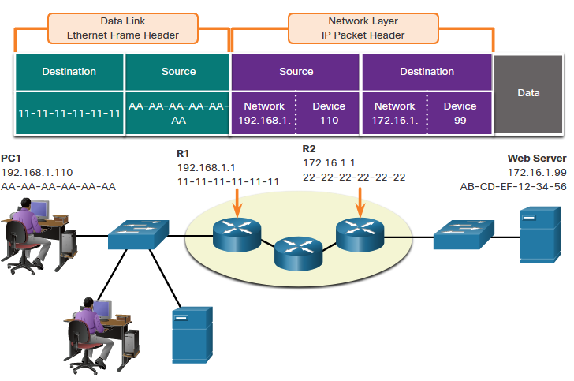
Data Access Devices on a Remote Network
What happens when the actual (ultimate) destination is not on the same LAN and is remote?
What happens when PC1 tries to reach the Web Server?
Does this impact the network and data link layers?
Notes:
3 – Protocols and Models
3.7 – Data Access
3.7.5 – Devices on a Remote Network

Slide 64
Data Access Role of the Network Layer Addresses
When the source and destination have a different network portion, this means they are on different networks.
PC1 – 192.168.1
Web Server – 172.16.1
Notes:
3 – Protocols and Models
3.7 – Data Access
3.7.6 – Role of the Network Layer Addresses

Slide 65
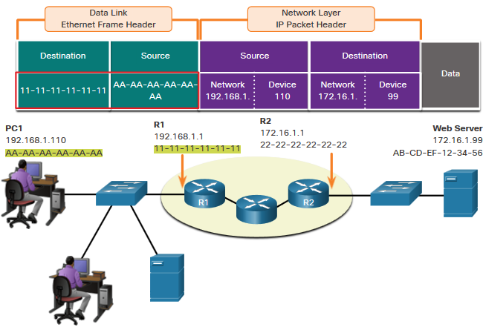
Data Access Role of the Data Link Layer Addresses: Different IP Networks
When the final destination is remote, Layer 3 will provide Layer 2 with the local default gateway IP address, also known as the router address.
The default gateway (DGW) is the router interface IP address that is part of this LAN and remote locationswill be the “door” or “gateway” to all other.
All devices on the LAN must be told about this address or their traffic will be confined to the LAN only.
Once Layer 2 on PC1 forwards to the default gateway (Router), the router then can start the routing process of getting the information to actual destination.
Notes:
3 – Protocols and Models
3.7 – Data Access
3.7.7 – Role of the Data Link Layer Addresses: Different IP Networks

Slide 66
Data Access Role of the Data Link Layer Addresses: Different IP Networks (Cont.)
The data link addressing is local addressing so it will have a source and destination for each link.
The MAC addressing for the first segment is :
Source – AA-AA-AA-AA-AA-AA (PC1) Sends the frame.
Destination – 11-11-11-11-11-11 (R1- Default Gateway MAC) Receives the frame.
Note: While the L2 local addressing will change from link to link or hop to hop, the L3 addressing remains the same.
Notes:
3 – Protocols and Models
3.7 – Data Access
3.7.7 – Role of the Data Link Layer Addresses: Different IP Networks (Cont.)

Slide 67
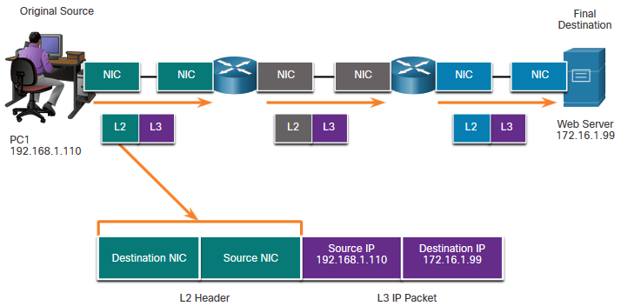
Data Access Data Link Addresses
Since data link addressing is local addressing, it will have a source and destination for each segment or hop of the journey to the destination.
The MAC addressing for the first segment is:
Source – (PC1 NIC) sends frame
Destination – (First Router- DGW interface) receives frame
Notes:
3 – Protocols and Models
3.7 – Data Access
3.7.8 – Data Link Addresses

Slide 68
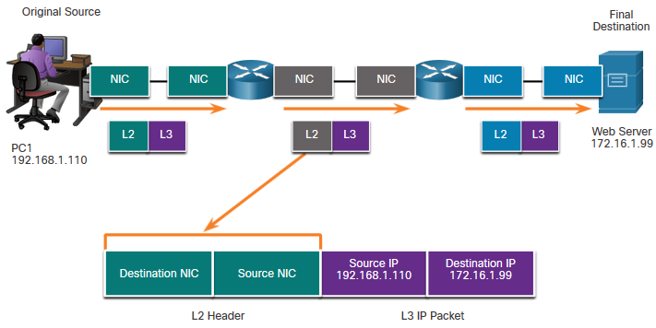
Data Access Data Link Addresses (Cont.)
The MAC addressing for the second hop is:
Source – (First Router- exit interface) sends frame
Destination – (Second Router) receives frame
Notes:
3 – Protocols and Models
3.7 – Data Access
3.7.8 – Data Link Addresses (Cont.)

Slide 69
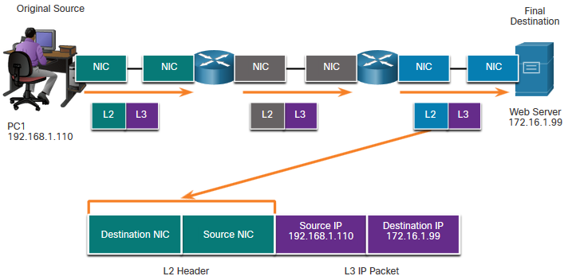
Data Access Data Link Addresses (Cont.)
The MAC addressing for the last segment is:
Source – (Second Router- exit interface) sends frame
Destination – (Web Server NIC) receives frame
Notes:
3 – Protocols and Models
3.7 – Data Access
3.7.8 – Data Link Addresses (Cont.)

Slide 70
Data Access Data Link Addresses (Cont.)
Notice that the packet is not modified, but the frame is changed, therefore the L3 IP addressing does not change from segment to segment like the L2 MAC addressing.
The L3 addressing remains the same since it is global and the ultimate destination is still the Web Server.
Notes:
3 – Protocols and Models
3.7 – Data Access
3.7.8 – Data Link Addresses (Cont.)

Slide 71
Data Access Lab – Install Wireshark
In this lab you will do the following:
Download and Install Wireshark
Notes:
3 – Protocols and Models
3.7 – Data Access
3.7.9 – Lab – Install Wireshark

Slide 72
Data Access Lab – Use Wireshark to View Network Traffic
In this lab, you will do the following:
Part 1: Capture and Analyze Local ICMP Data in Wireshark
Part 2: Capture and Analyze Remote ICMP Data in Wireshark
Notes:
3 – Protocols and Models
3.7 – Data Access
3.7.10 – Lab – Use Wireshark to View Network Traffic
3.7.11 – Check Your Understanding – Data Access

Slide 73
3.8 Module Practice and Quiz
Notes:
3 – Protocols and Models
3.8 – Module Practice and Quiz

Slide 74
Module Practice and Quiz What did I learn in this module?
The Rules
Protocols must have a sender and a receiver.
Common computer protocols include these requirements: message encoding, formatting and encapsulation, size, timing, and delivery options.
Protocols
To send a message across the network requires the use of several protocols.
Each network protocol has its own function, format, and rules for communications.
Protocol Suites
A protocol suite is a group of inter-related protocols.
TCP/IP protocol suite are the protocols used today.
Standards Organizations
Open standards encourage interoperability, competition, and innovation.
Notes:
3 – Protocols and Models
3.8 – Module Practice and Quiz
3.8.1 – What did I learn in this module?

Slide 75
Module Practice and Quiz What did I learn in this module? (Cont.)
Reference Models
The two models used in networking are the TCP/IP and the OSI model.
The TCP/IP model has 4 layers and the OSI model has 7 layers.
Data Encapsulation
The form that a piece of data takes at any layer is called a protocol data unit (PDU).
There are five different PDUs used in the data encapsulation process: data, segment, packet, frame, and bits
Data Access
The Network and Data Link layers are going to provide addressing to move data through the network.
Layer 3 will provide IP addressing and layer 2 will provide MAC addressing.
The way these layers handle addressing will depend on whether the source and the destination are on the same network or if the destination is on a different network from the source.
Notes:
3 – Protocols and Models
3.8 – Module Practice and Quiz
3.8.1 – What did I learn in this module? (Cont.)
3.8.2 – Module Quiz – Protocols and Models

Slide 76
New Terms and Commands
encoding protocol channel flow control response timeout acknowledgement unicast multicast broadcast protocol suite Ethernet standard proprietary protocol | 802.3 (Ethernet) 802.11 (wireless Ethernet) segmentation default gateway Hypertext Transfer Protocol (HTTP) Simple Mail Transfer Protocol (SMTP) Post Office Protocol (POP) Transmission Control Protocol (TCP) transport data link network access Advanced Research Projects Agency Network (ARPANET)
Notes:
3 – Protocols and Models
New Terms and Commands

Slide 77
New Terms and Commands (Cont.)
Internet Message Access Protocol (IMAP) File Transfer Protocol (FTP) Trivial File Transfer Protocol (TFTP) User Datagram Protocol (UDP) Network Address Translation (NAT) Internet Control Messaging Protocol (ICMP) Open Shortest Path First (OSPF) Enhanced Interior Gateway Routing Protocol (EIGRP) Address Resolution Protocol (ARP) Dynamic Host Configuration (DHCP) | encapsulation de-encapsulation protocol data unit (PDU) segment packet frame
Notes:
3 – Protocols and Models
New Terms and Commands (Cont.)

